Slide 1
Efficient Packet Pattern Matching for Gigabit Network Intrusion Detection using GPUs
Date:102/1/9
Publisher:IEEE HPCC 2012
Author:Che-Lun Hung, Hsiao-hsi Wang, Chin-Yuan Chang, Chun-Yuan Lin
Presenter : Shi-qu Yu

Slide 2
GPGPU PROGRAMMING
Global Memory
Global memory is the biggest memory region available
on CUDA devices and is capable of storing hundreds of megabytes of data. In the CUDA Fermi architecture [17], the
L1 cache per SM multiprocessor is configurable to support the global memory operations. Therefore, the access latency of global memory is comparable to other GPU memory architectures.

Slide 3
GPGPU PROGRAMMING
Constant Memory
Constant memory is a small read-only memory region
that resides in DRAM on CUDA devices. It is globally
accessible memory for all threads. Since Constant memory
has on-chip cache, the access latency is short. The cost of a
cache-hit is as a local register access, but the cost of a cache miss is as a global memory access on devices. The constant
memory is limited to its size.

Slide 4
GPGPU PROGRAMMING
Texture memory
Each multi-processor on the CUDA device equips a 64KB texture cache which can be bound to one or more arbitrarily sized region of global memory. Texture memory is read only as constant memory.

Slide 5
GPGPU PROGRAMMING
Shared memory
Shared memory is block-local that facilitates cooperation
between multiple threads in a thread block. Shared memory
is limited to 64KB per multi-processor on CUDA Fermi devices. The access latency of shared memory is equivalent to that of register.

Slide 6
GPGPU PROGRAMMING
Registers
Each block on CUDA device equips a register file that
contains registers. The register provides fast thread-local
storage during kernel execution. In the Fermi architecture,
each multi-processor contains the amount of 32-bit registers
(32,000) that are shared for all threads in the executing
thread block.

Slide 7
Method
Initialization
Pattern Matching processing on GPU
Data Output

Slide 8
Method
Initialization
ZeroCopy
Page-locked memory
Each thread searches in n bytes where n is the maximum pattern length. Therefore, the total size of combined packets is
L = n X T

Slide 9
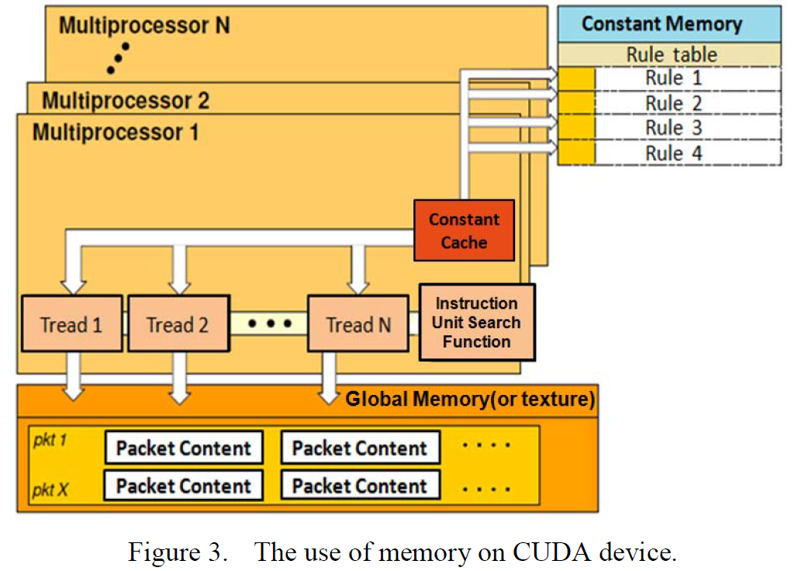
Method

Slide 10
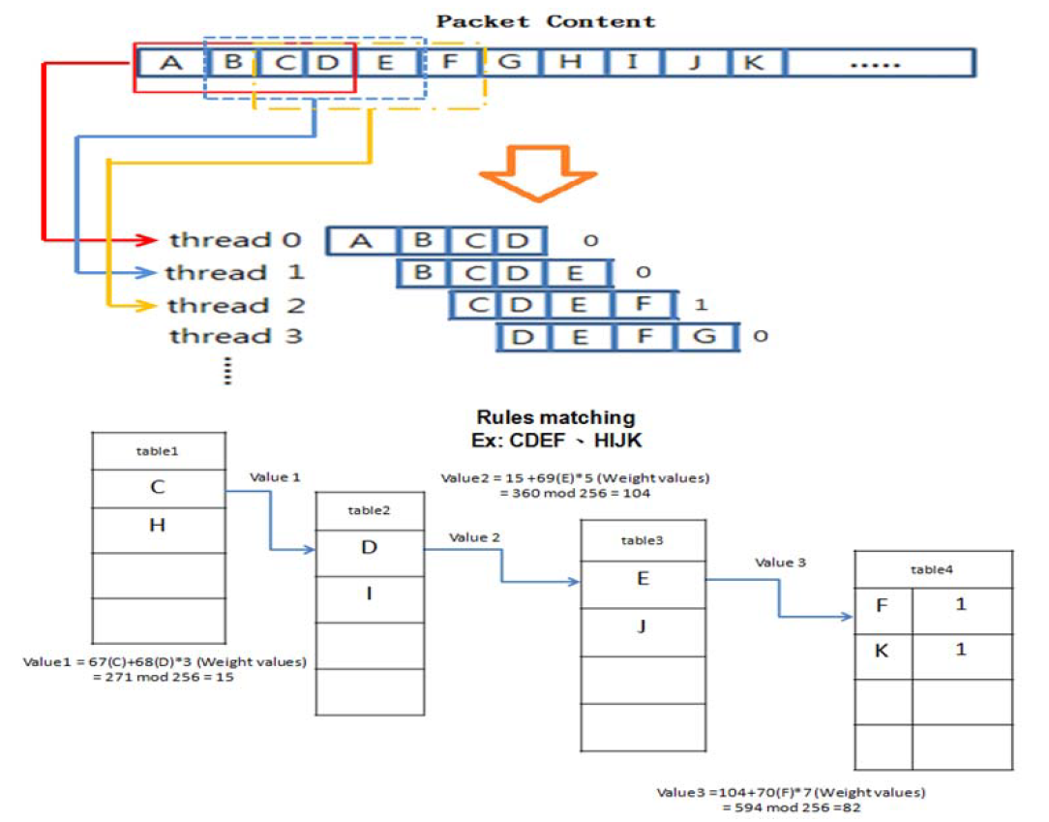

Slide 11
EXPERIMENT
CPU | Intel i3 540 3.07GHz
Host memory | 8GB DDRIII-1333
GPU | GeForceGTS 450

Slide 12
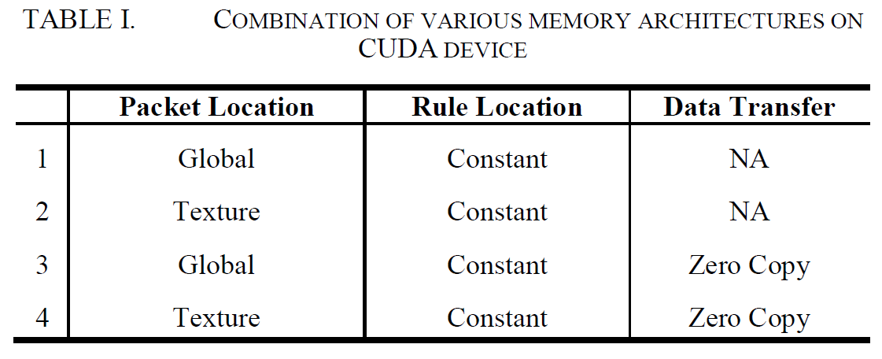
EXPERIMENT

Slide 13
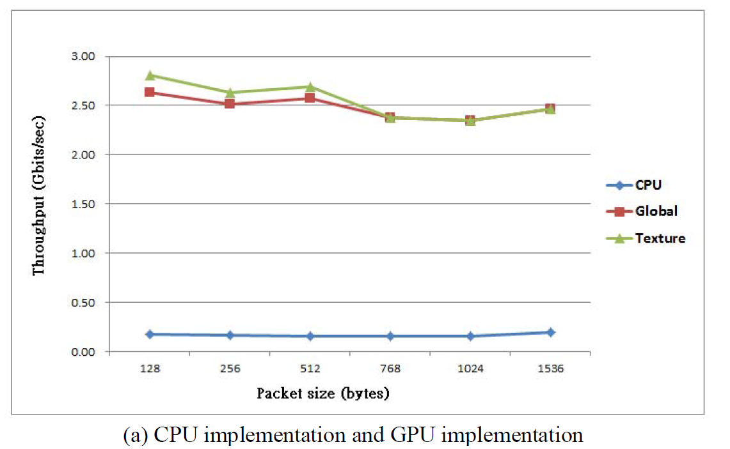
EXPERIMENT

Slide 14
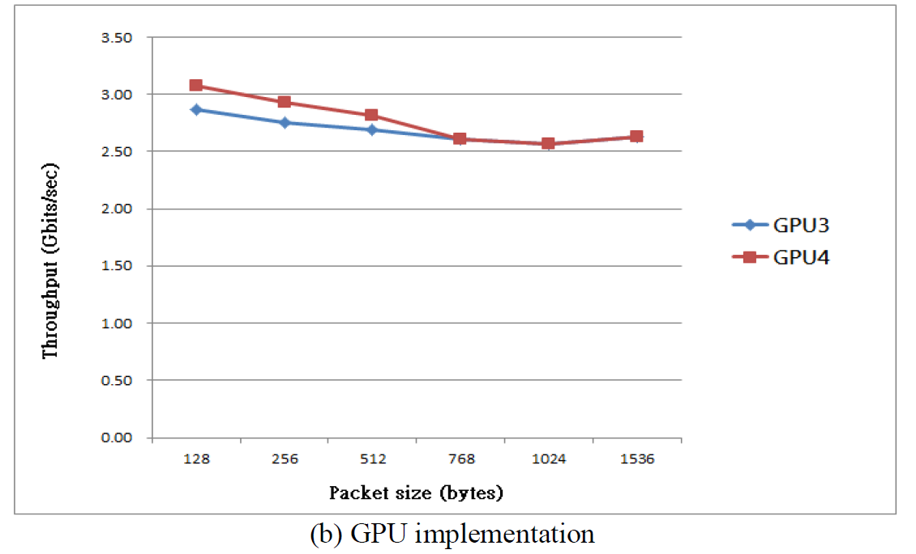
EXPERIMENT

